Slide 1
Presentation on Plagiarism Detection In Nepali
Presented By:
Ankit B.K. (THA076BCT006)
Ayush Batala (THA076BCT011)
Mishan Thapa Kshetri (THA076BCT019)
Nishant Uprety (THA076BCT023)
Department of Electronics and Computer Engineering
Institute of Engineering, Thapathali Campus
January 6, 2023

Slide 2
Outline
Motivation
Objectives
Scope of Project
Project Application
Methodology
Results and Analysis
Remaining Tasks
References

Slide 3
Motivation
Lack of Plagiarism Detection in Nepali Language
No provision for detection of Plagiarism in:
Nepali theses
Journal articles
Research papers[1]

Slide 4
Objectives
To prepare dataset for Plagiarism Detection in Nepali language.
To build a functioning prototype of Plagiarism Detection Software.

Slide 5
Scope of Project
Verification of authenticity of Research.
Approval of honest work in Journalism
Fails to identify common knowledge and observable facts
Doesn’t consider diagrams, charts or other visual materials

Slide 6
Project Application
Plagiarism detection in Nepali academia.
Prevents instances of copied and pasted text and light paraphrasing of texts.
User-friendly and available on multiple platforms.

Slide 7
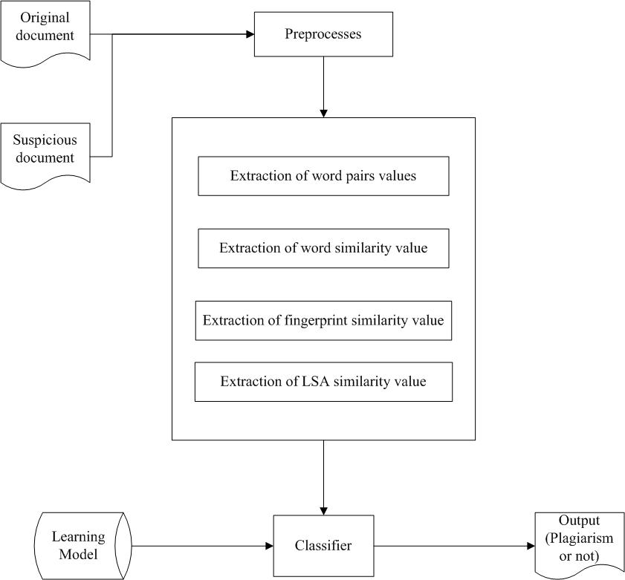
Methodology

Slide 8
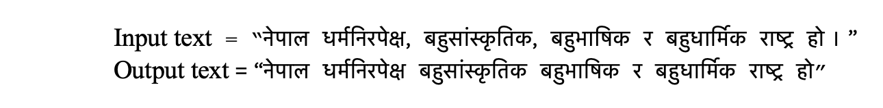
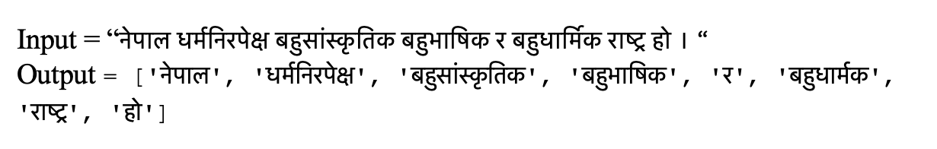
Methodology
Preprocessing
Punctuation removal
Tokenization

Slide 9
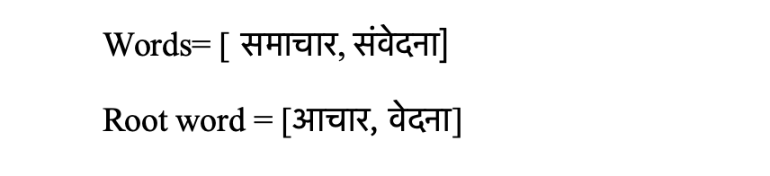
Methodology
Stop word removal
Irrelevant words for analysis
{अक्सर, अगाडि, अनि, अन्यथा, आदि, उनले, एकदम, etc }
Lemmatization
Converting the word into root word/lemma

Slide 10
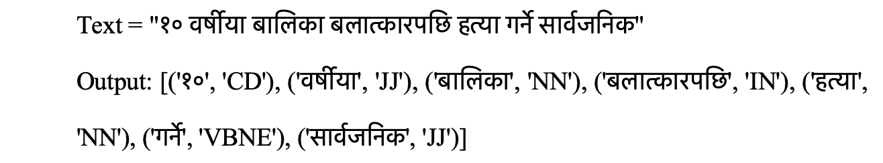
Methodology
POS tagging
Assigning the Part of Speech to each word

Slide 11
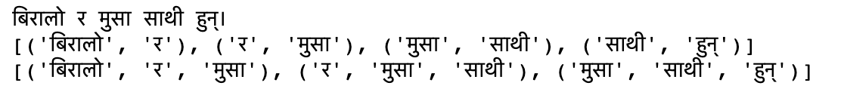
Methodology
N-grams or Word Pair
contiguous sequences of n words from text
Bigrams =
Trigrams =
Fig: Example of ngrams

Slide 12
Methodology
N-grams
Captures the context and structure of the text
Quickly identifies instances of plagiarism in real-time,
Most common feature extraction technique used
Ppchecker uses this technique[2]

Slide 13
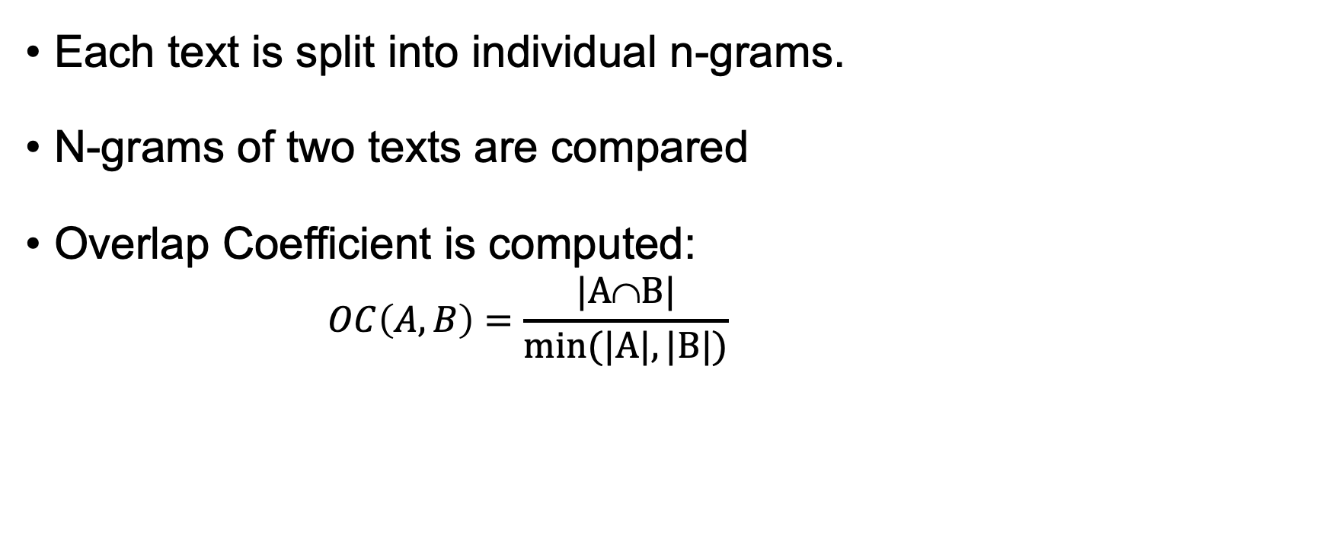
Methodology
Each text is split into individual n-grams.
N-grams of two texts are compared
Overlap Coefficient is computed:
$$OC\left(A,B\right)=\frac{|A∩B|}{min⁡(|A|,|B|)}$$

Slide 14
Methodology
Word Similarity
Degree of similarity between two text based on their meaning.
Assigning the POS tag for each Nepali tokens.
Matching of words considering the POS tag.
Compute Overlap Coefficient.

Slide 15
Methodology
Fingerprint Similarity
Fingerprints are unique identifiers for documents.​
Identification of document depends upon its content and structure.​
Minhashing for Fingerprint Similarity.

Slide 16

Methodology
N-grams algorithm returns an array of n-subsequences.​
64-bit hash value is generated by Minhashing.

Slide 17
Methodology
Latent Semantic Analysis
Analyses association
Identifies underlying topics
Create structured data from a collection of unstructured texts.

Slide 18
Methodology
Implementation
Preprocess the documents​
Term by document matrix form ​
Assign weight to matrix entries​
Singular Value Decomposition (SVD) is performed​
Compute similarity

Slide 19
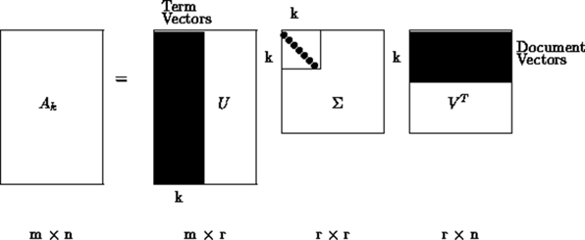
Methodology
What is SVD?​
Factorization of matrix into three matrices​
Tool for dimension reduction

Slide 20
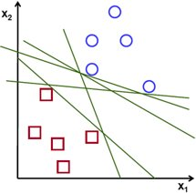
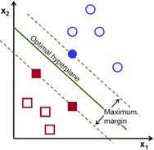
Methodology
Support Vector Machine
Classification algorithm using hyperplane.​
Finds the hyperplane that maximally separates two classes.[2]

Slide 21
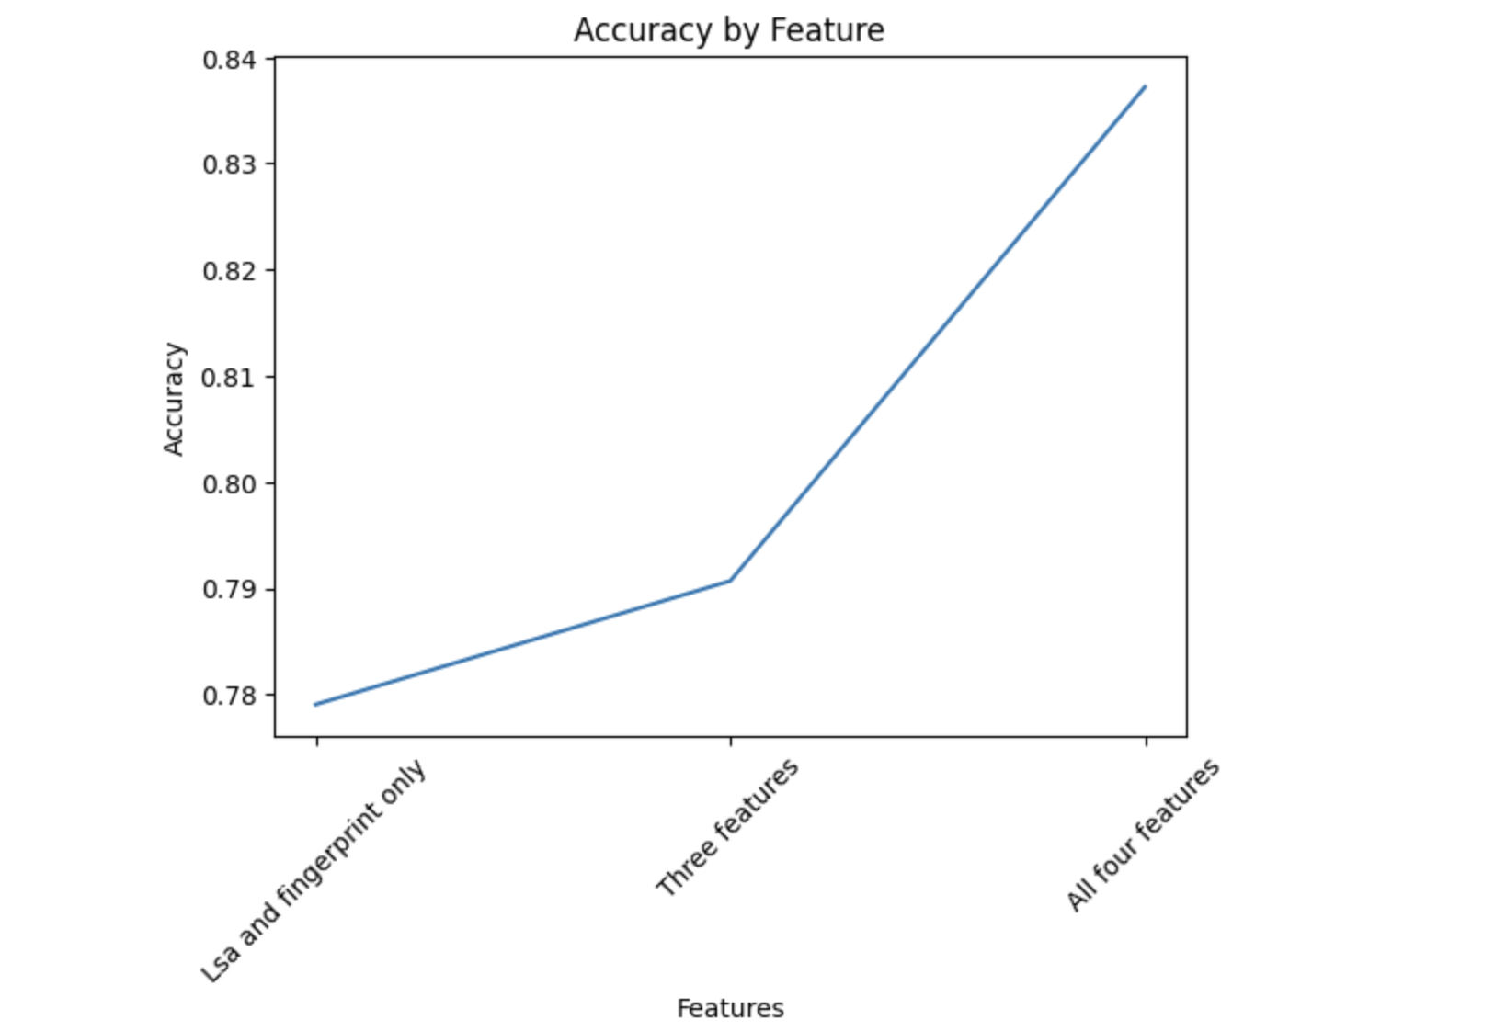
Results and Analysis
Fig: Accuracy vs Features from English data

Slide 22
Results and Analysis
Direct relations between features and accuracy
77% accuracy with LSA and Fingerprint only
79% when Bigram was added
84% when all features were used

Slide 23
Results and Analysis
Conclusions from analysis of English dataset:
All features are vital
Overlap coefficient over Jaccard/Cosine coefficient
Need of large dataset
Need of only SVM instead of Naïve Bayes

Slide 24
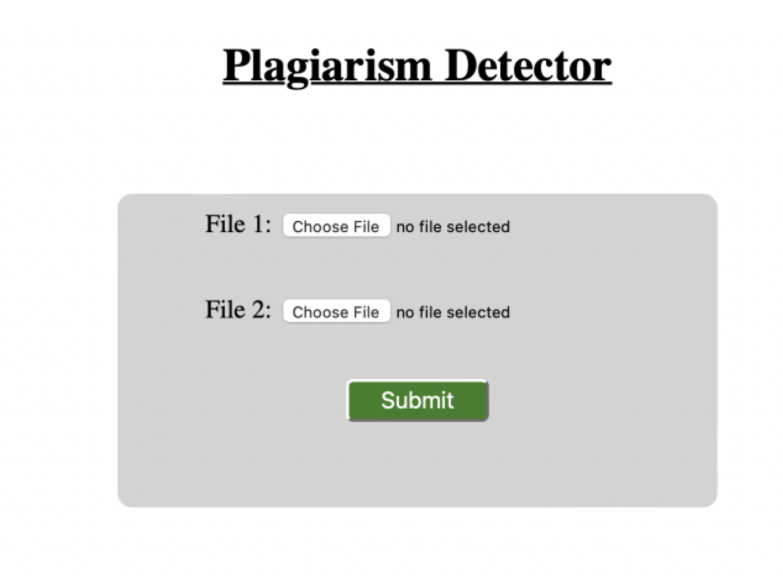
Results and Analysis
Fig:Application Interface

Slide 25
Remaining Tasks
Completion of dataset preparation of Nepali language
Lemmatization in Nepali words
Assigning POS tag to Nepali tokens
Calculation of word similarity using Word2vec embeddings
.

Slide 26
References
O. i. C. R. C. F. E. I. A. D. (CERID), Interviewee, Plagiarism Detection in Nepali Language. [Interview]. January 2023.
Kang, N., Gelbukh, A., “PPChecker: Plagiarism Pattern Checker in Document Copy Detection", Springer, Heidelberg (2006)
B. N. A. S. a. N. H. Eva Y Puspaningrum, "Detection of Text Similarity Using Winnowing Algorithm Based K-gram and Jaccard Coefficient," Journal of Physics: Conference Series, 2019.

